Slide 1

Lina Mahardiani, S.T., M.Sc., Ph.D
Chemistry Education
Surakarta, July 4th 2020

Slide 2


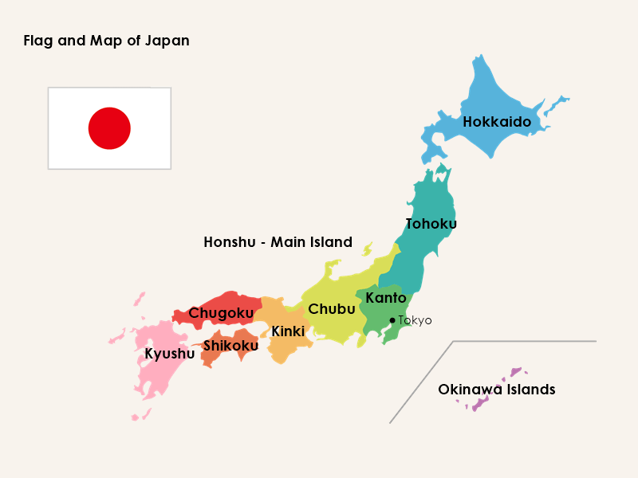
JAPAN – GENERAL INFORMATION
Geography
Japan is an island country.
It consists, essentially, of five major islands – Honshu (Main Island), Hokkaido (North Island), Kyushu, Shikoku and the Okinawa Islands – and 6,847 remote islands.
Its total area is 337,961.32 sq km,
Population
The population of Japan is estimated at 126.5 million as of 2020
https://www.japanexplorer.com.au/facts-of-japan-general-information/
Language
Japanese (日本語)

Slide 3
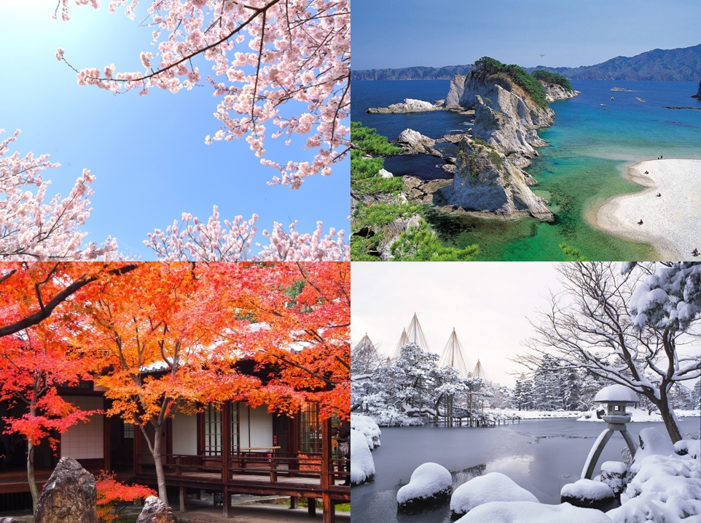
JAPAN – GENERAL INFORMATION
Spring 春 (Haru)
Summer 夏 (Natsu)
Autumn 秋 (Aki)
Winter 冬 (Fuyu)

Slide 4
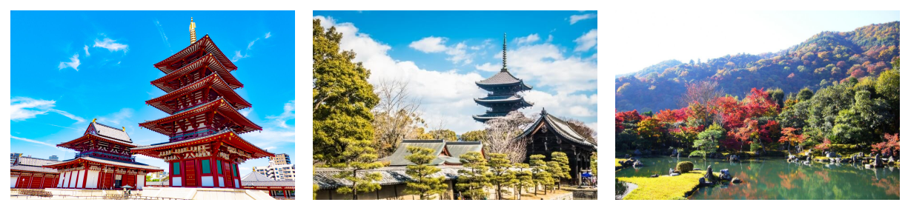

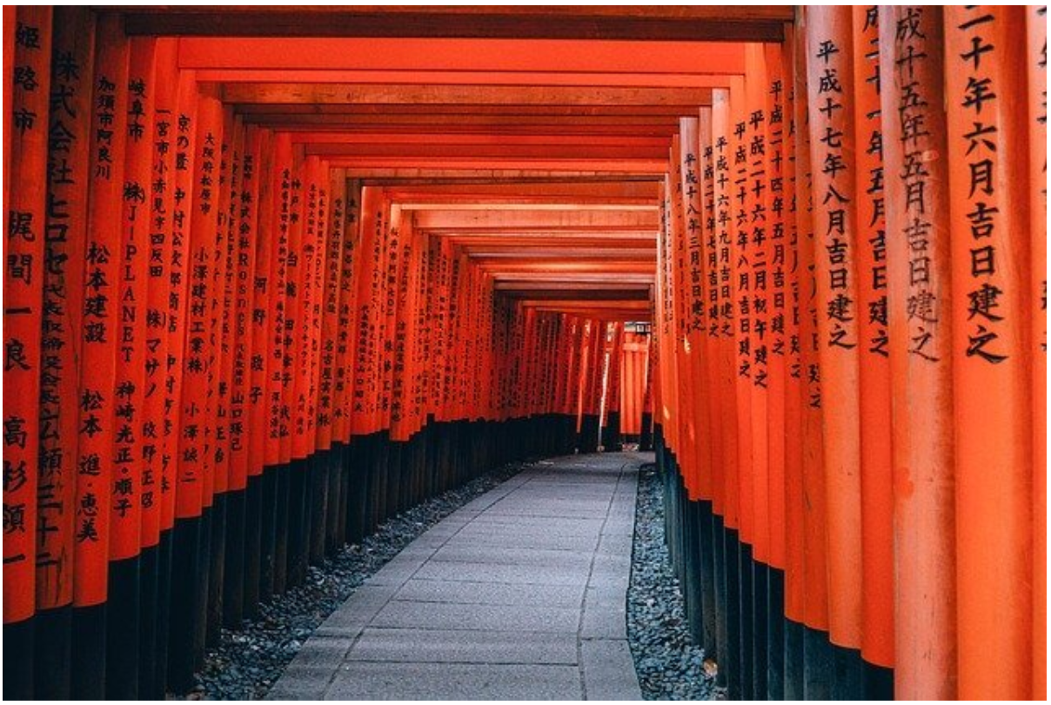
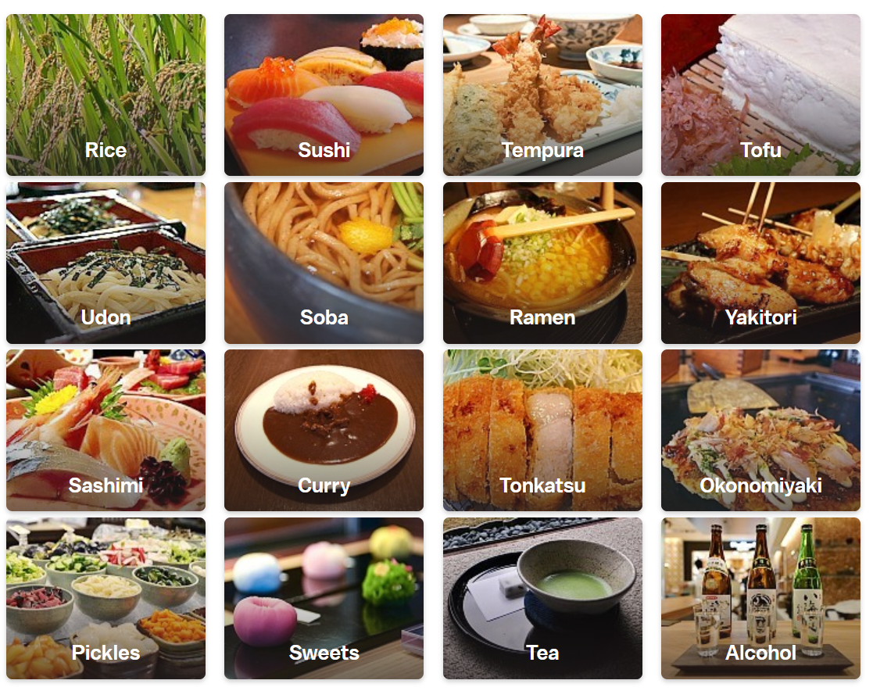


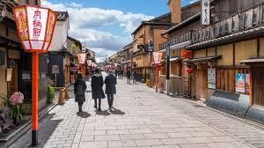
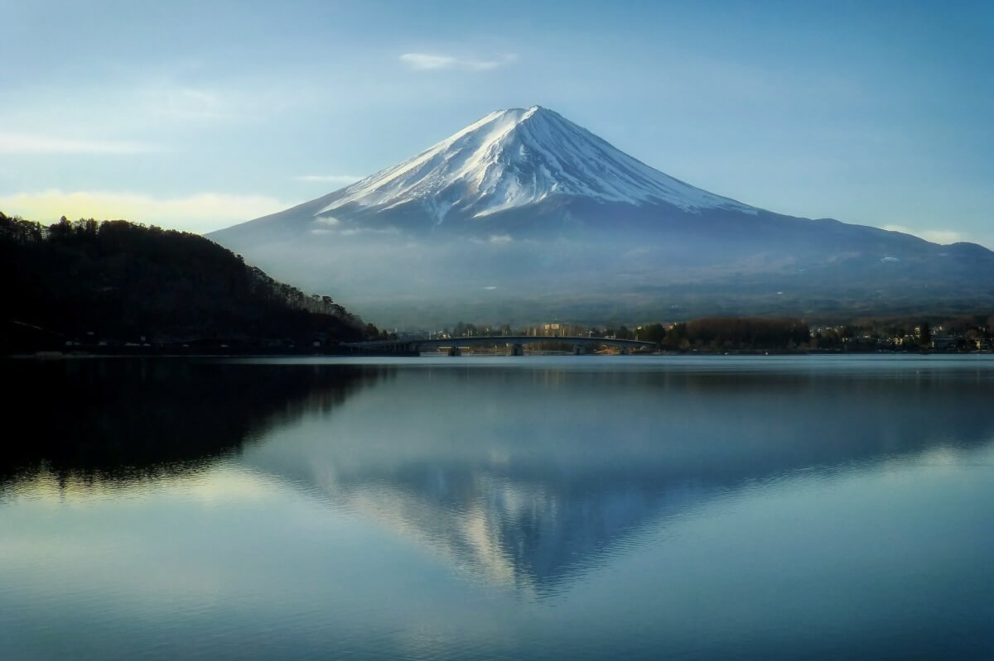
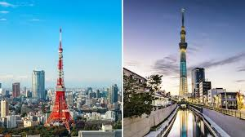

REASONS TO VISIT JAPAN
1. It’s easy to get around on public transportation
2. Japan is very clean
3. Japanese people are polite and friendly
4. The incredible natural landscapes
5. The superb Japanese cuisine
6. The fantastic architecture
7. The advanced technology
8. Japan is very safe
9. Japan is a Mecca for manga and anime lovers

Slide 5
REASONS TO STUDY IN JAPAN
High educational standards
The OECD ranks Japanese high school students number one in the world for maths, and number 2 for scientific literacy.
Japan has the highest number of Nobel prize winners of any Asian country, and the second highest of any country since 2000.
49% of Japanese High School graduates enter university.
Japan has over 700 universities, with 10 ranked in the top 200 worldwide.
See the world, develop as a person
Studying abroad gives you an unparalleled opportunity to live, work and explore a different culture.
Living overseas will help you develop as a person, becoming independent and taking responsibility. It will help you to see things from new perspectives, and appreciate the differences between cultures, while also seeing the deep similarities between people.
Learning doesn't just happen in the classroom; meeting people from different cultures and making friends from all over the world are also important parts of growing up.

Slide 6
REASONS TO STUDY IN JAPAN
Learn Japanese while earning a degree
Studying on international program allows you to learn Japanese all the way throughout your degree program, while also earning a degree in another subject.
Student who wish to remain in Japan and work after graduation may enjoy a significant advantage over language majors, who may have comparable Japanese levels, but who lack the degree specific skills.
Japan is a safe, peaceful place to study
Japan is one of the safest countries in the world. Violent crime is rare, with Japan ranking last in the number of victims of crime per capita (nationmaster.com).
Japan also has one of the world's most advanced healthcare systems, reflected in this high life expectancy. Members of the National Health Insurance scheme pay only 30% of their healthcare costs, with a trip to the doctor or dentist often costing only a few hundred yen (few dollars).

Slide 7
REASONS TO STUDY IN JAPAN
Improving your employability
Study abroad is an impressive part of any resume. Employers value the skills you learn as an international student. As well as the personal growth you will undergo studying in Japanese institution, interacting with your professors, classmates, tutors and friends, will help improve your international awareness and employment opportunities.
Internationally aware employees are in strong demand, and many companies actively recruit students with overseas learning experience - especially if they are able to speak a second language. If you choose to return home after graduation, you can be confident that your experience in Japan will help you appeal to high-quality employers.
For this wishing to remain in Japan, there is a strong job market for highly qualified graduates. In a recent survey, around half of the major Japanese companies surveyed expressed a desire to hire foreigners graduating from Japanese institutions.

Slide 8
REASONS TO STUDY IN JAPAN
Low tuition fees and generous scholarships
Tuition fees are comparatively cheap in Japan. While an "in state" student in the US may spend $10,000 a year or more on tuition, with "out of state" and international fees being several times higher, tuition fees at Japanese public universities are a mere 535,800 yen (approx $5,500) a year.
Furthermore, at partial and full tuition fees waivers are even possible for high achieving students from poorer backgrounds in most of Japanese universities.
Furthermore, a wide range of scholarships are available, both from the university, and from public and private organizations.

Slide 9
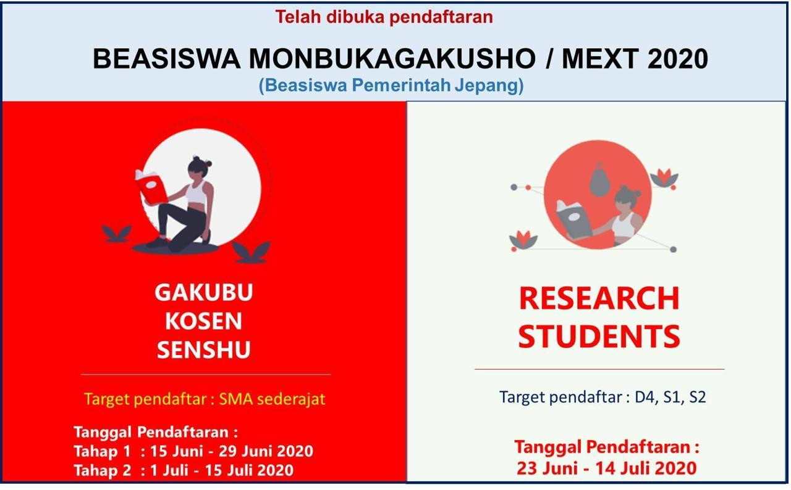
SCHOLARSHIP TO STUDY IN JAPAN
https://www.id.emb-japan.go.jp/sch.html

Slide 10
SCHOLARSHIP TO STUDY IN JAPAN
https://www.mext.go.jp/en/policy/education/highered/title02/detail02/sdetail02/1373897.htm
Embassy recommendation
University recommendation
https://www.jasso.go.jp/en/study_j/scholarships/brochure.html
https://www.jasso.go.jp/en/study_j/scholarships/index.html
Scholarship offers by the university of your choice
https://www.global.hokudai.ac.jp/admissions/scholarships/
http://www.tsukuba.ac.jp/en/students/finance/scholarships
https://www.u-tokyo.ac.jp/en/prospective-students/mext_scholarship.html

Slide 11


Beasiswa Lembaga Pengelola Dana Pendidikan
Beasiswa LPDP merupakan skema beasiswa dari Kementrian Keuangan Republik Indonesia yang dikelola oleh Lembaga Pengelola Dana Pendidikan Indonesia:
Pendanaan penuh meliputi SPP, bulanan, tunjangan keluarga, asuransi, buku, dll.
Umum
Afirmasi
Targeted group
Regular
Dokter spesialis
Perguruan tinggi utama dunia
Disertasi
Kerjasama pendanaan
Afirmasi
Alumni Bidikmisi
Prasejahtera berprestasi
Santri
Prestasi olahraga dan seni internasional
Penyandang disabilitas
Indonesia Timur
Beasiswa unggulan
PNS
Olimpiade sains, teknologi dan ekonomi
Link: www.lpdp.kemenkeu.go.id

Slide 12
Alur pendaftaran beasiswa LPDP
Registrasi di https://beasiswalpdp.kemenkeu.go.id/
Melengkapi berkas secara online
Seleksi tahap 1:
Seleksi administrasi
Seleksi tahap 2:
Tes berbasis computer (khusus program Magister)
Seleksi tahap 1:
Wawancara
Link: www.lpdp.kemenkeu.go.id

Slide 13
Tips lolos beasiswa LPDP
Registrasi dan upload dokumen
Sebelum melakukan registrasi, baca dengan cermat persyaratan yang dapat diunduh di www.lpdp.kemenkeu.go.id.
Ketika melakukan upload dokumen, pastikan dokumen yang diupload adalah benar dan tidak tertukar satu dengan yang lainnya.
Membuat essay yang realistis dan rencana studi yang matang di kampus tujuan.
Upload seluruh achievements yang dimiliki.
Usahakan memiliki Letter of Acceptance sebelum melakukan pendaftaran.
Memiliki pengalaman exchange dan pernah publish di jurnal internasional menjadi nilai tambah yang tinggi.
Chek dan re-cek lagi sebelum melakukan submission.
Wawancara
Persiapkan wawancara sedini mungkin dan latihan sesering mungkin.
Pelajari lagi essay dan rencana studi yang telah diupload.
Jawab setiap pertanyaan dengan jujur dan rendah hati.
Link: www.lpdp.kemenkeu.go.id

Slide 14

LIVING IN JAPAN
Settling Down in Japan/Supporter
Meet and greet at Airport or Station
Guidance to your dormitory or temporary accommodation
Assistance with procedures at your local ward or city office to keep your records up to date on your place of residence, obtain National Health Insurance, They will also help you open a bank account.
Complete all entrance procedures at your department
Apply for Japanese language courses (availability is limited)
If you do not have one: search for a scholarship
Go to orientation
https://www.global.hokudai.ac.jp/university-life/arrive-and-thrive/supporter-system/

Slide 15
LIVING IN JAPAN
Campus/Daily Life
Know the rules in the lab, ex: be punctual, work hard, polite.
Actively engage with all activities, ex: cleaning lab, sports tournament, zemi.
Avoiding troubles, ex: disposing garbage, sharing facilities, noise cautions, pay tax, avoiding cults
Join interchange activities, ex: international student association, make friend with Japanese, learning Japanese language or customs, part time job, home stay

Slide 16
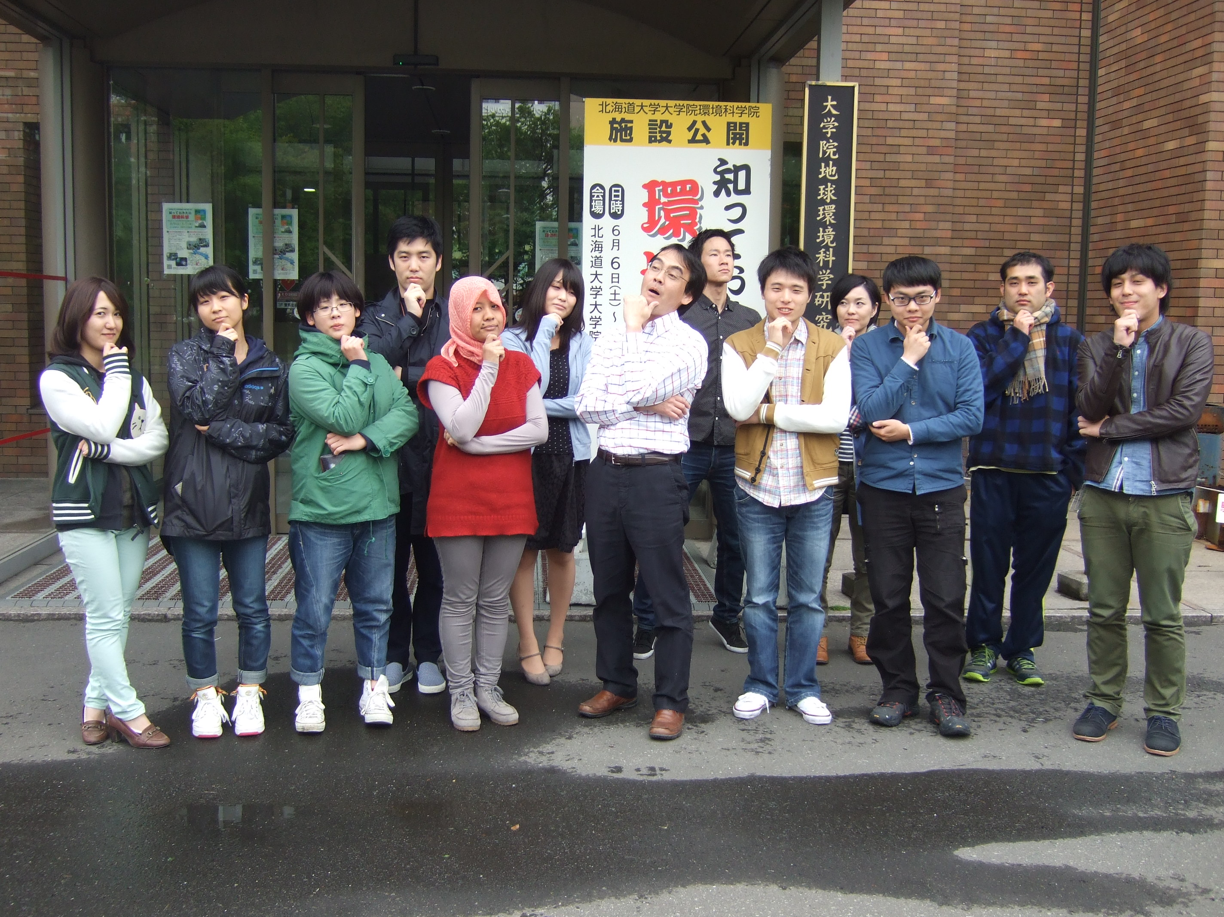
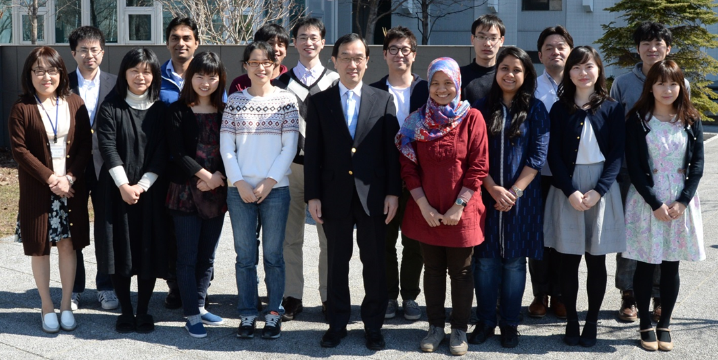
LIVING IN JAPAN –
Lab Member
Kamiya Lab
Fukuoka Lab

Slide 17
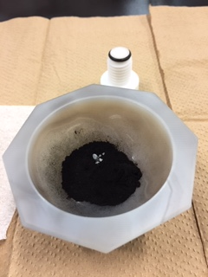
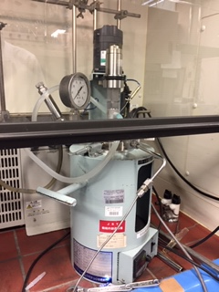
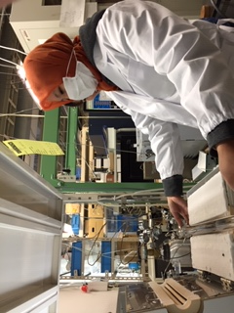
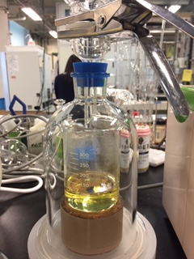
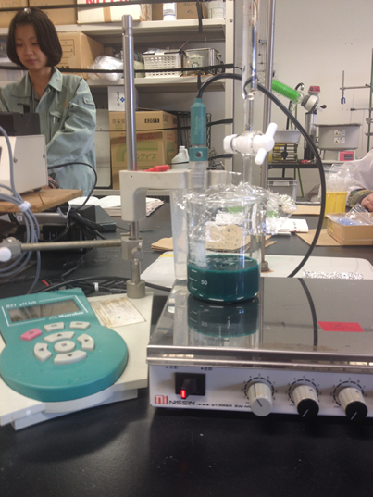
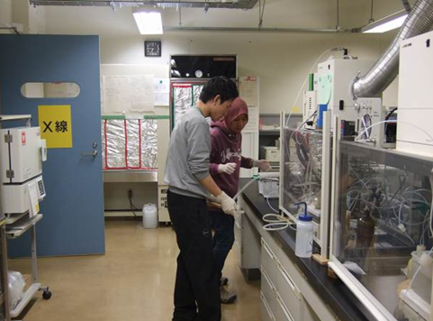
LIVING IN JAPAN-
Research

Slide 18


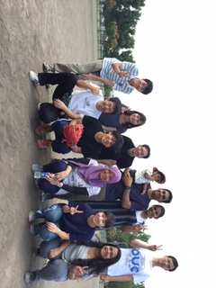
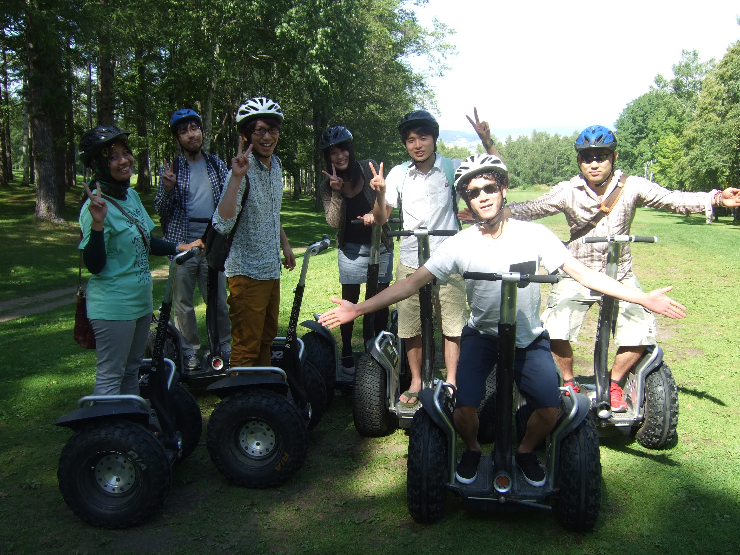
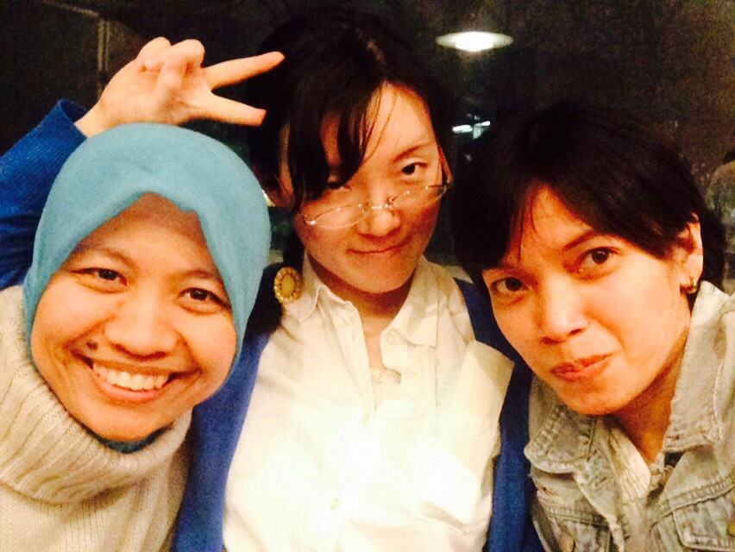
LIVING IN JAPAN –
Social

Slide 19
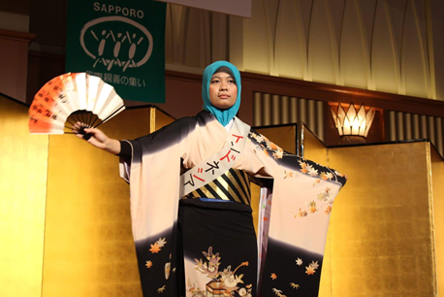
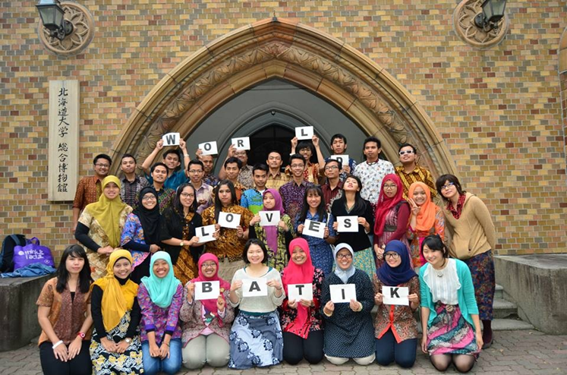
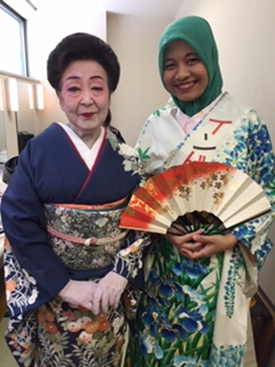
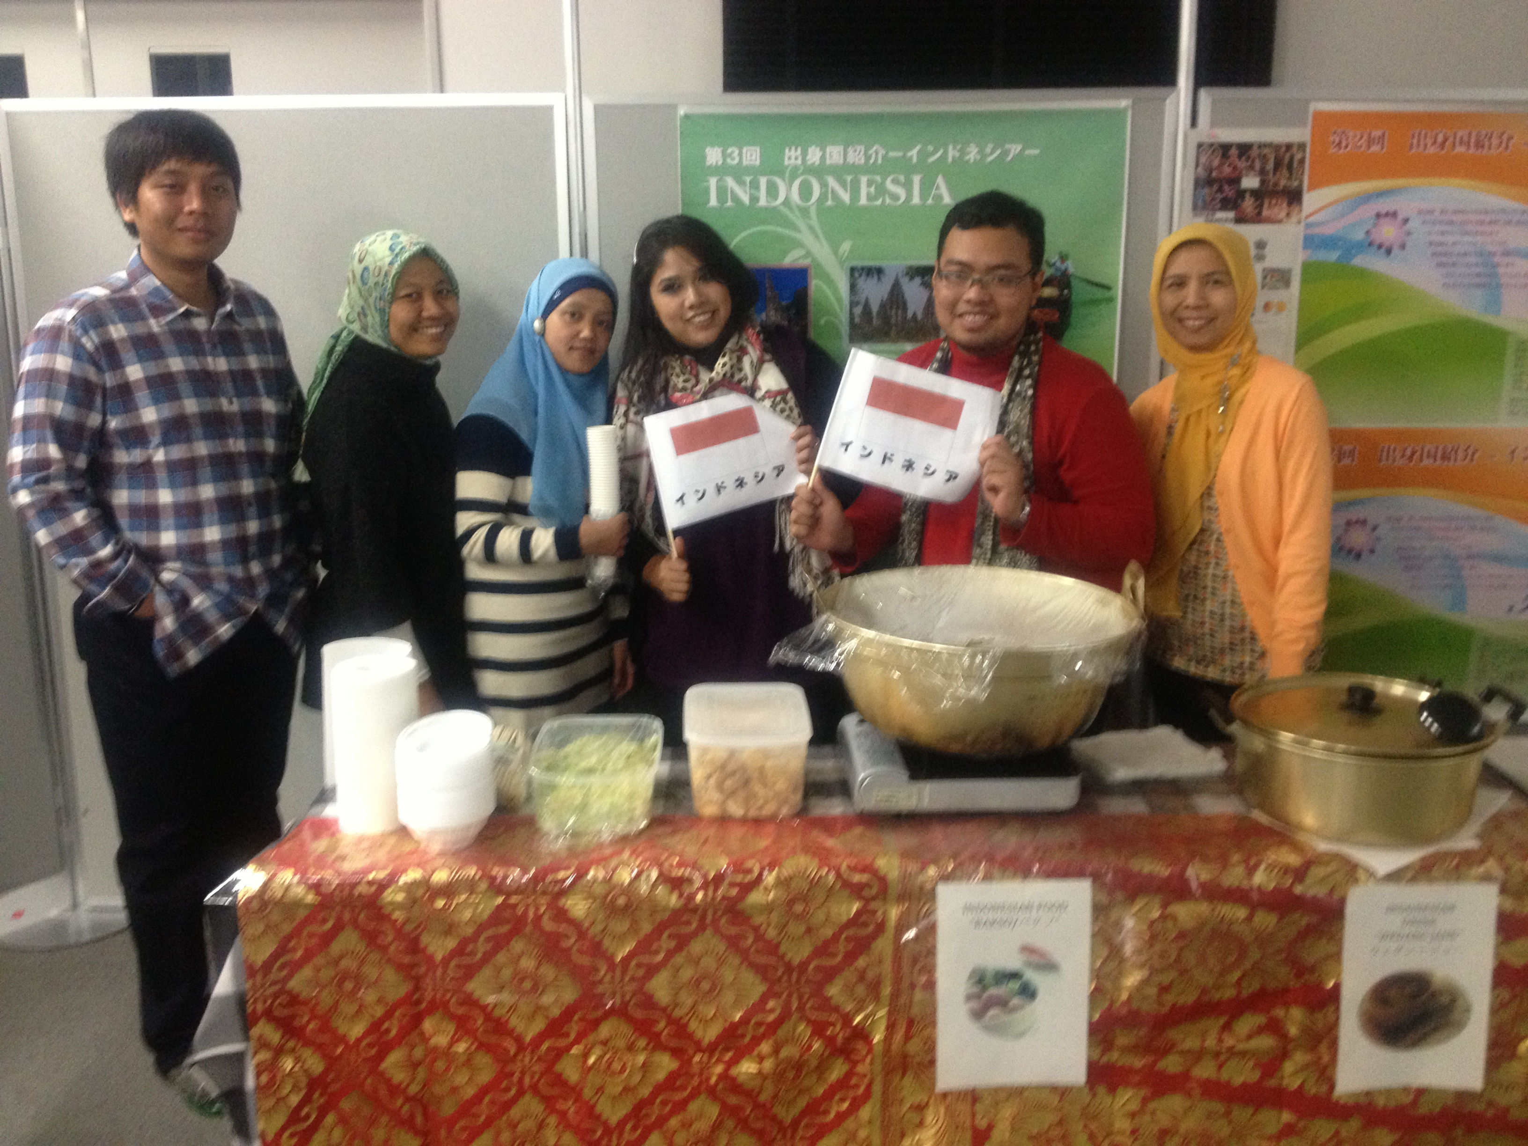
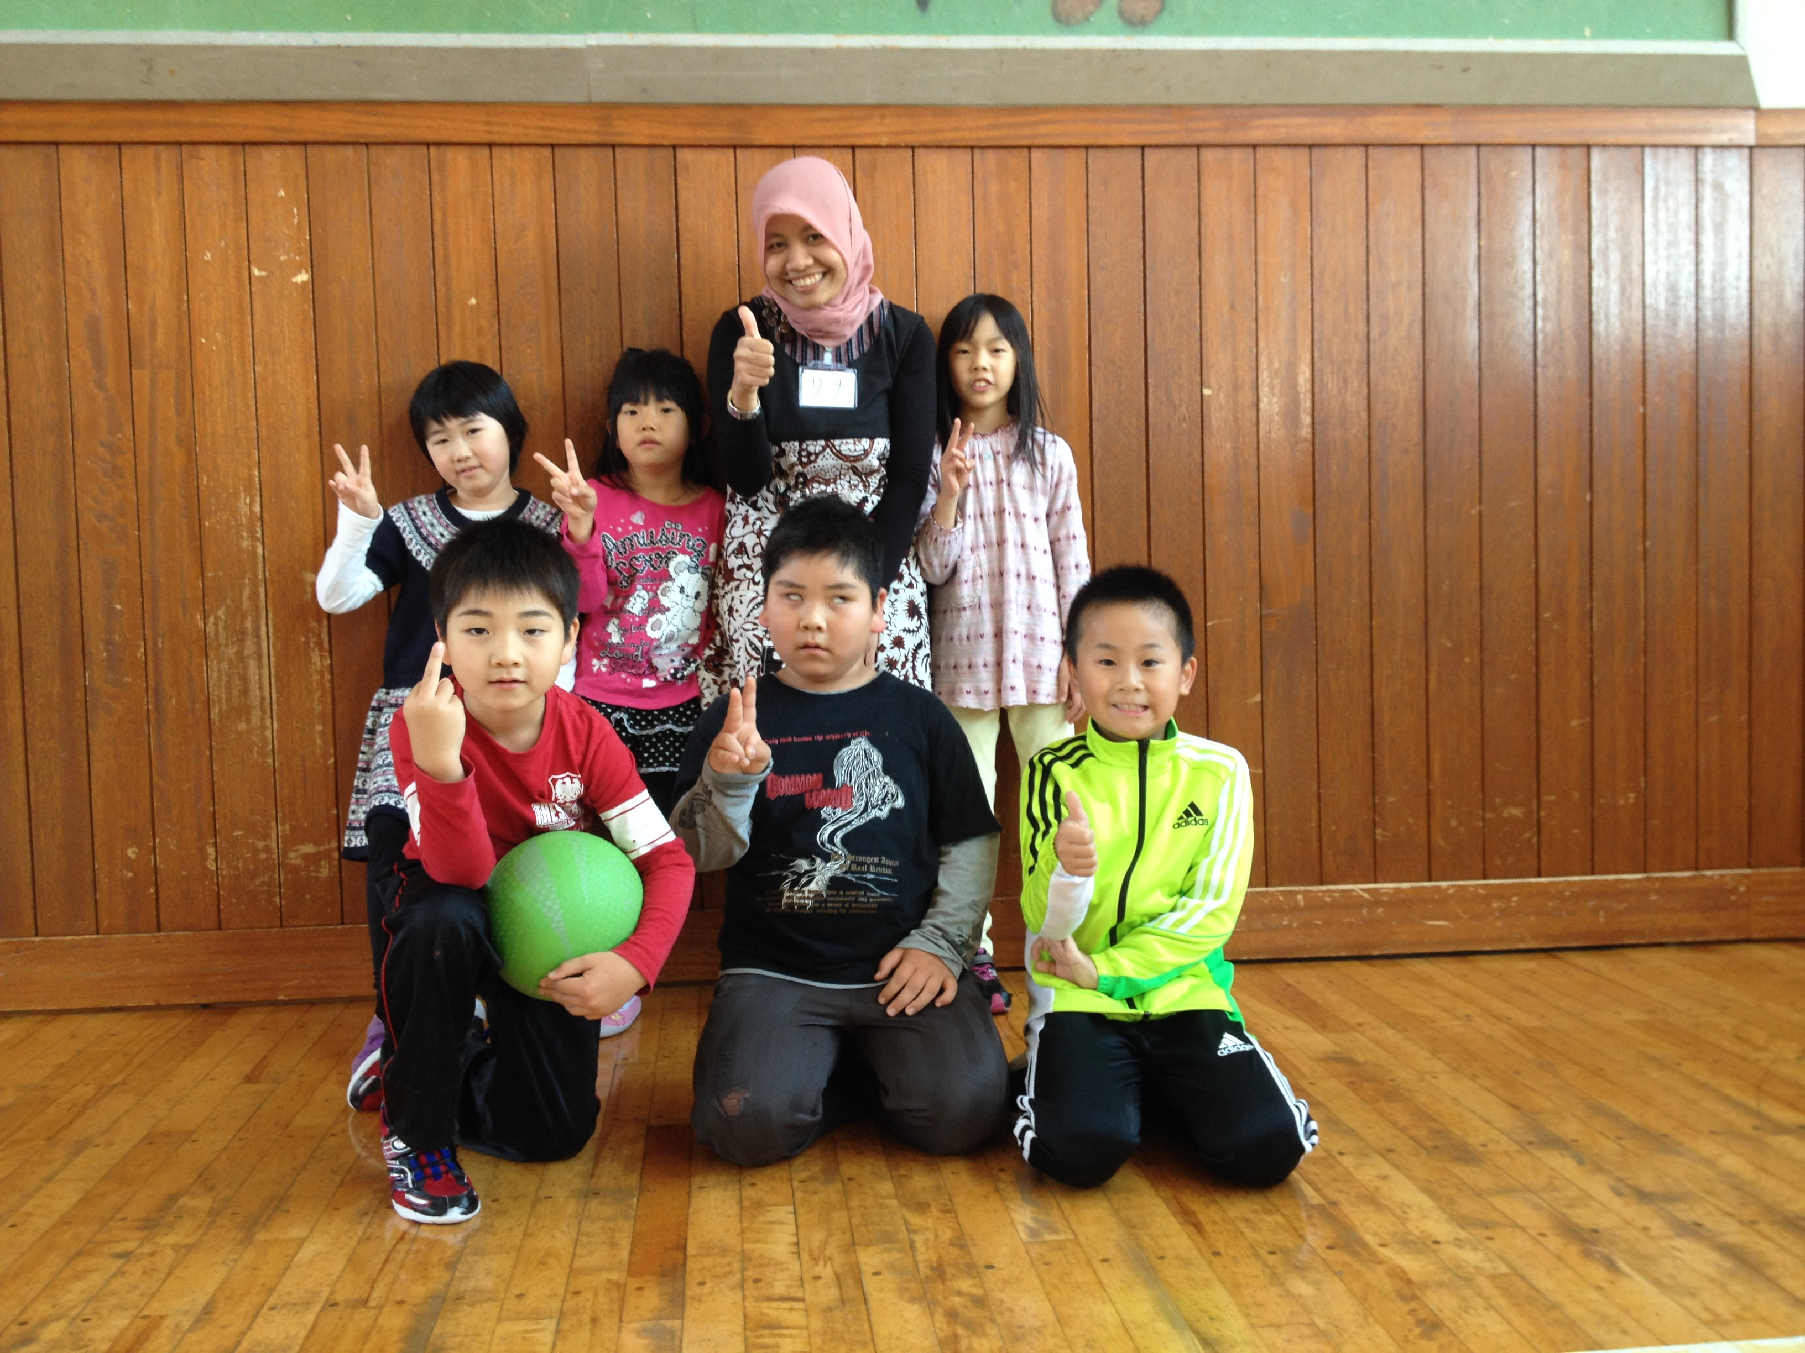
LIVING IN JAPAN –
Cultural

Slide 20
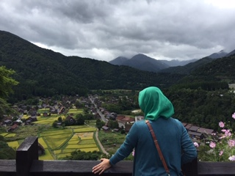
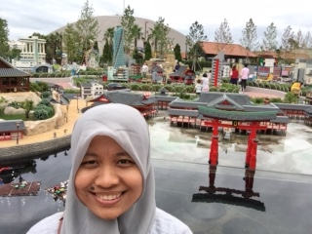
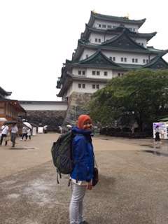
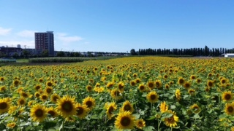
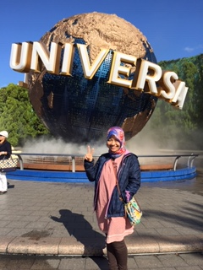
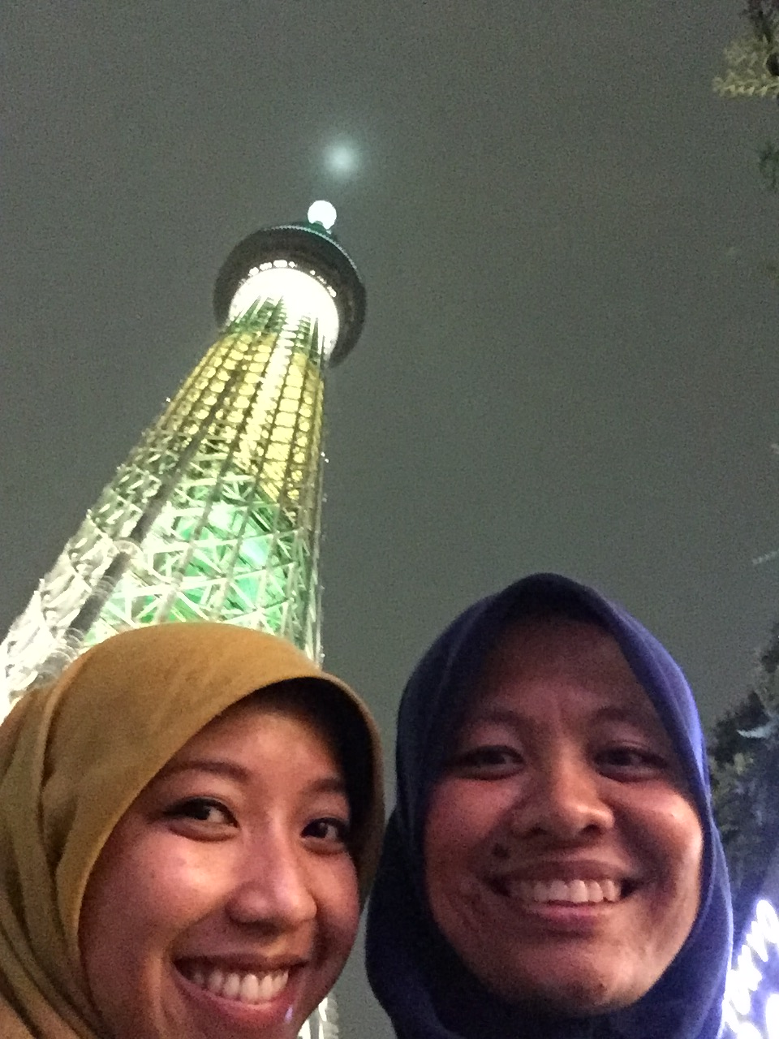
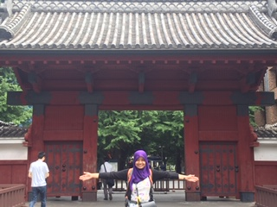
LIVING IN JAPAN –
Sight Seeing

Slide 21
THANK YOU

